Slide 1
Secure System Development - Dr Cathryn Peoples Prototype System based on Monolithic and distributed Paradigm International Space Station Project - The Ambassadors -

Slide 2

Team Members
Adam Cox
Uzayr Parak
David Bouret
Yohay Samson

Slide 3
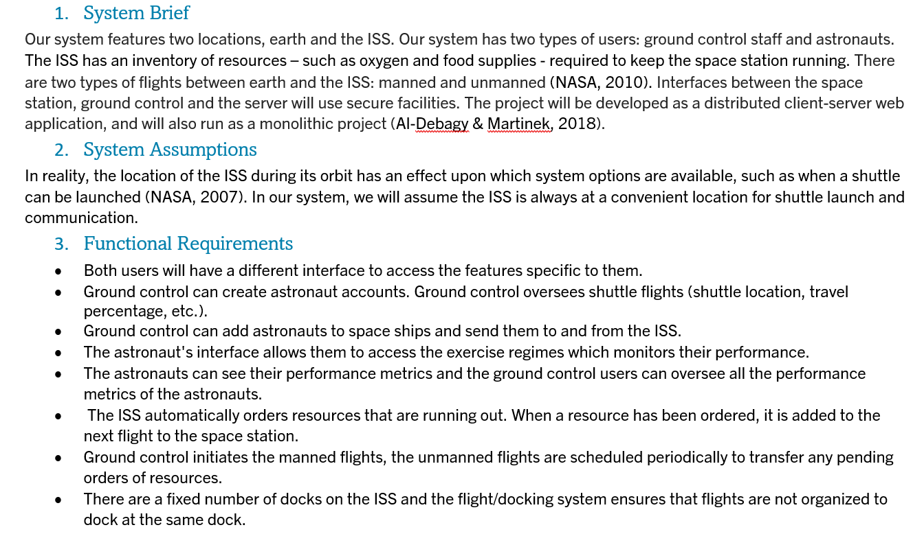
Development Process
4. Non-functional Requirements
The system will be available for use 24 hours a day, 7 days a week. Regulatory – The project will comply with the GDPR (Appendix A) Security - Mitigations will be taken to protect the attack surfaces and sensitive data (Section 6, Appendix E) Recoverability –The system mustn't crash. We will use error handling to catch exceptions and handle them appropriately. We will make our database transactions ATOMIC so that if any part of the transactions fails the whole transaction is cancelled and no fragmented data is added. Maintainability – We will use good OOP practices to keep the codebase maintainable. We will provide some documentation to help other developers understand the system. (Section 9) Domain-specific requirements - Data transfer will be affected by latency, as the ISS is a considerable distance from the control office. In addition, there will need to be a backup internet connectivity service in the event the main internet service fails. We do not want to lose communication between the ISS at any stage.
-Design Document-

Slide 4
Security Principles
Design with:
OWASP Secure Coding Practices Injection Broken Authentication Sensitive Data Exposure XML External Entities (XXE) Broken Access Control Security Misconfiguration Cross-Site Scripting (XSS) Insecure Deserialisation Using Components with Known Vulnerabilities Insufficient Logging & Monitoring | Saltzer and Schroeder Security Principles Economy of Mechanism Least Privilege Open Design Fail-Safe Defaults Separation of Privilege The Least Common Mechanism Complete Mediation Psychological Acceptability Work Factor Compromise Recordings

Slide 5
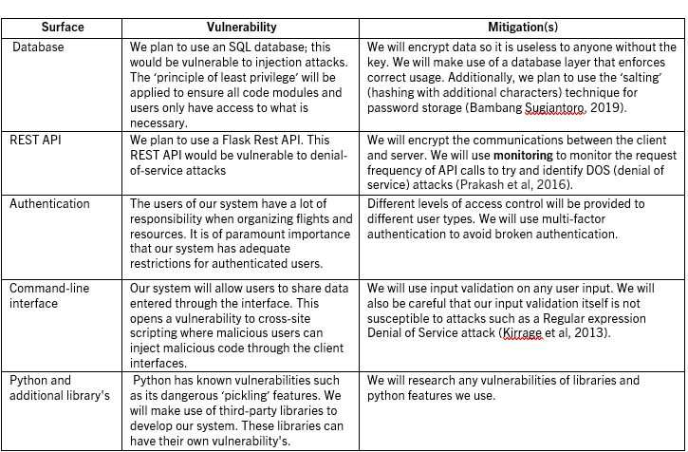
Attack Surfaces

Slide 6
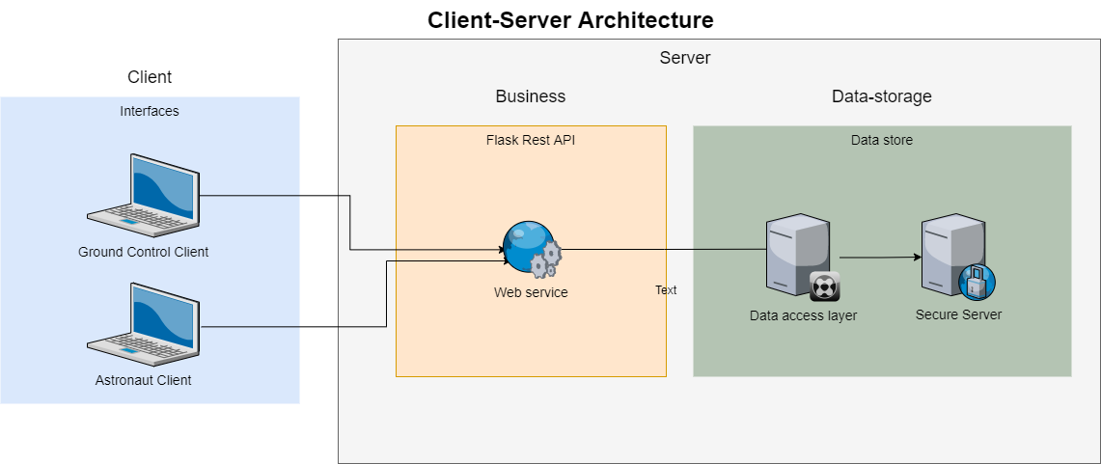
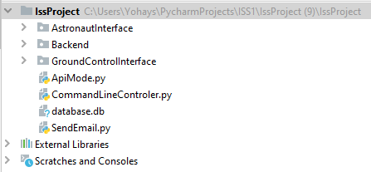
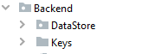
Architecture and presentation
Client Server
3 Tier Architecture
-Code structure-

Slide 7
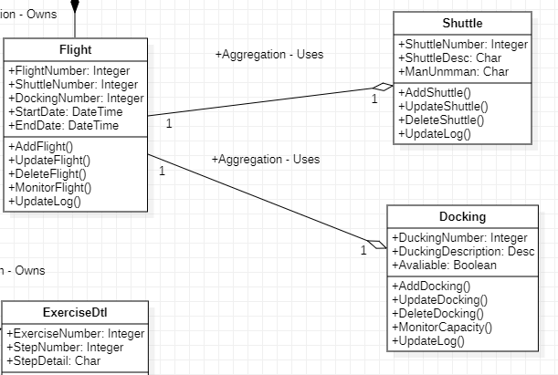
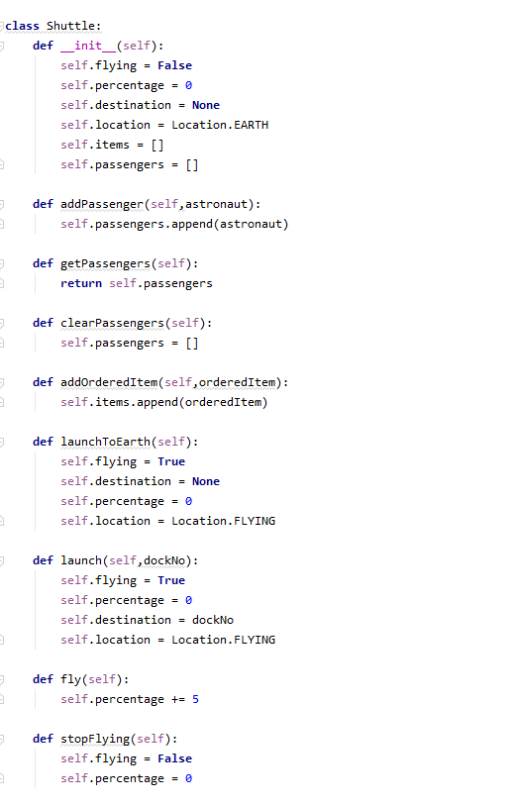
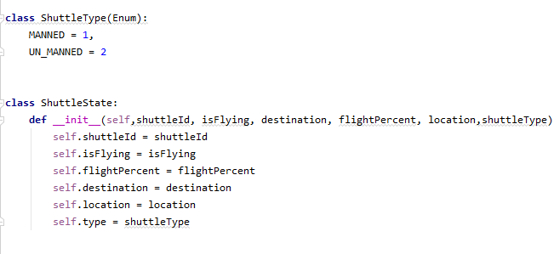
Relation Class Diagram

Slide 8
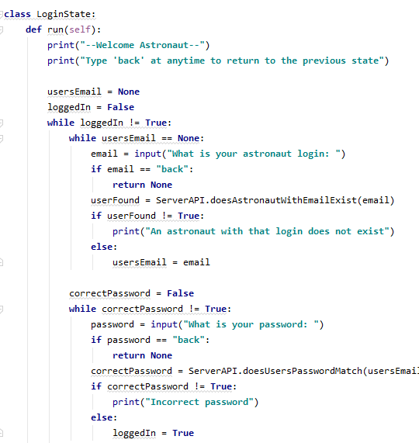
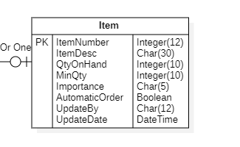
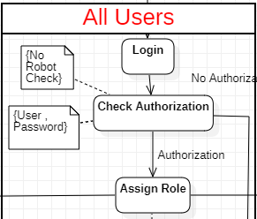
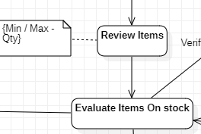
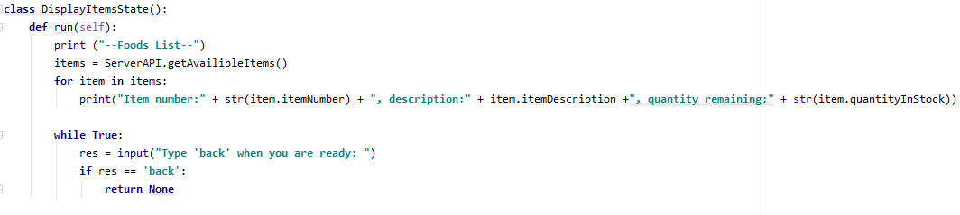
Relation to Activity Diagram & ERD

Slide 9
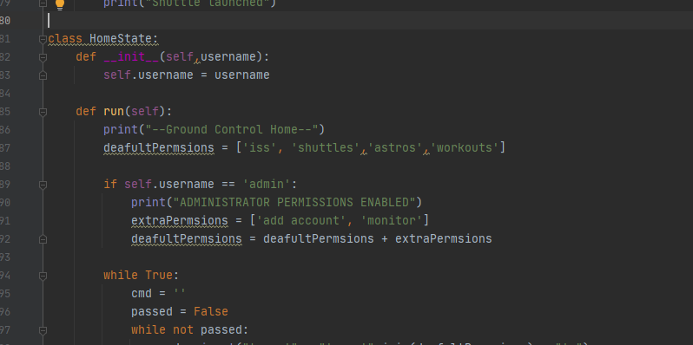
Functional requirements breakdown
Both users will have a different interface to access the features specific to them.
Privileges :
Fail Safe Defaults (Saltzer and Schroeder Principles) - As a default, we have limited access controls, with all permissions only enabled for the admin account. For all other accounts, permission will be given if and when needed. Insert code or presentation.
Hide’s user passwords.
Doesn't save user’s passwords.

Slide 10
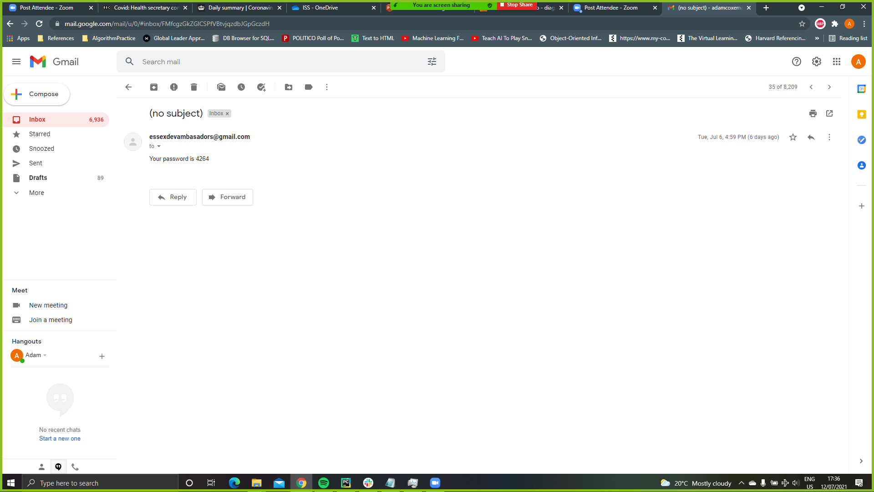
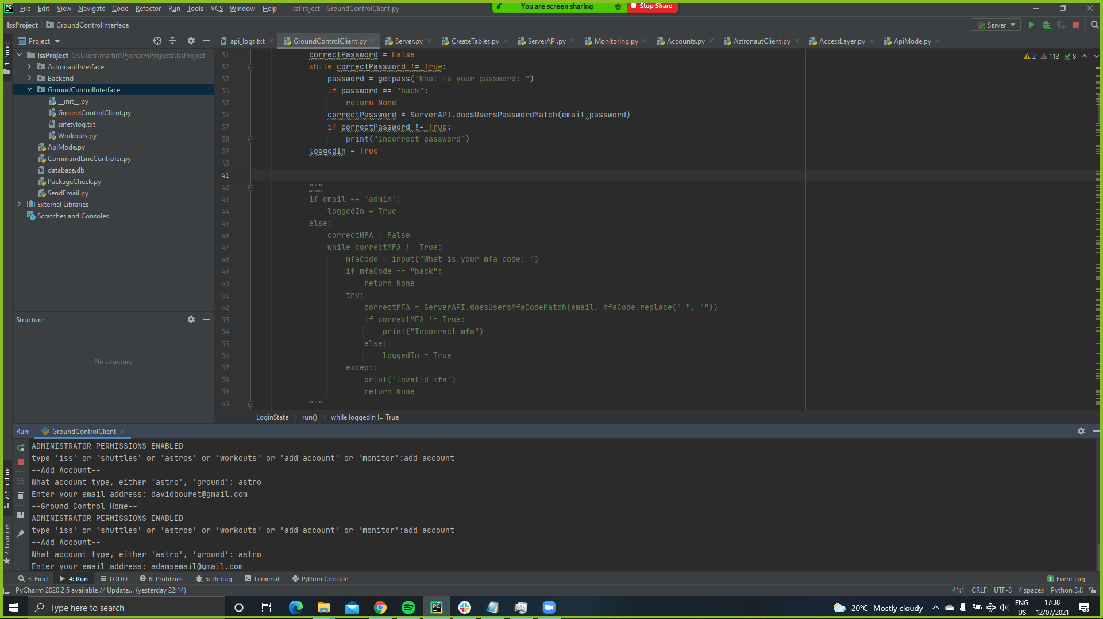
Functional requirements breakdown
Both users will have a different interface to access the features specific to them
Login
Separation of privileges (Saltzer and Schroeder Principles) . We have implemented a simple multi-factor authentication. We verify the users email when the register their account.

Slide 11
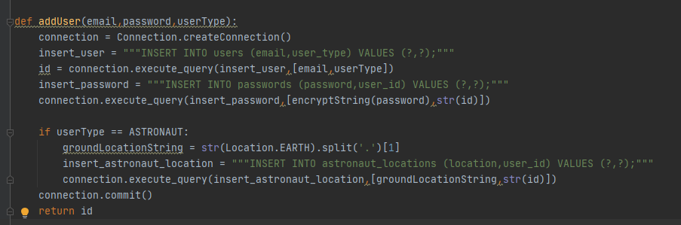
Functional requirements breakdown
Both users will have a different interface to access the features specific to them
Ground control can add astronauts to shuttles and send them to and from the ISS.
Atomic operation.
CRUD
-Atomic Implementation-

Slide 12
Requirements Breakdown
Breakdown as to how our choice of system architecture dictates the security implementations
Distributed System
Server
Logging
Vulnerability monitoring
Rest API
DDOS Monitoring
HTTPS Protocol (Public certificate private key)
Advanced privilege key
Data access layer
Data integrity enforced by SQL constraints
Client
Input validation
Doesn’t store username and passwords
Obfuscate password input

Slide 13
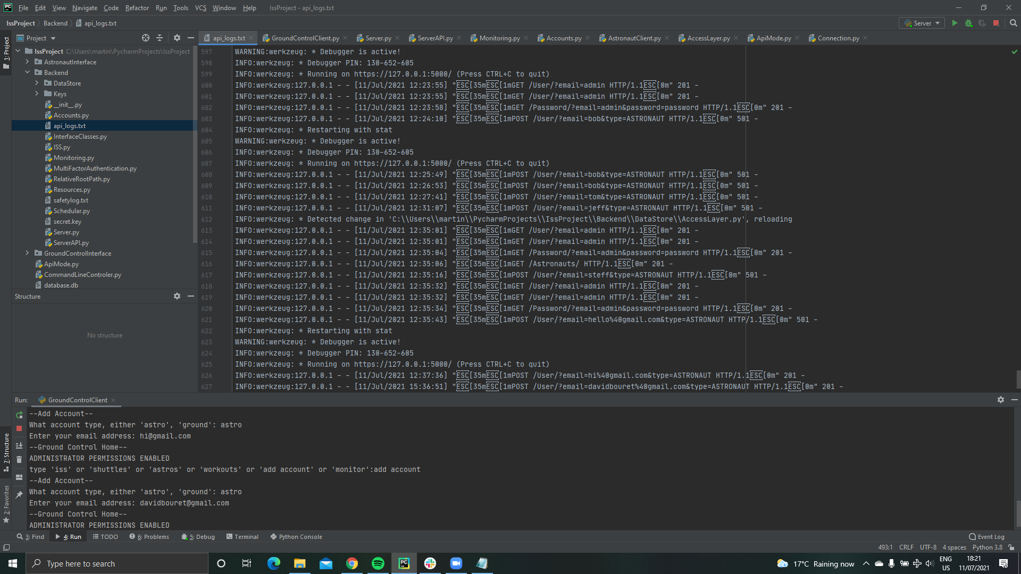
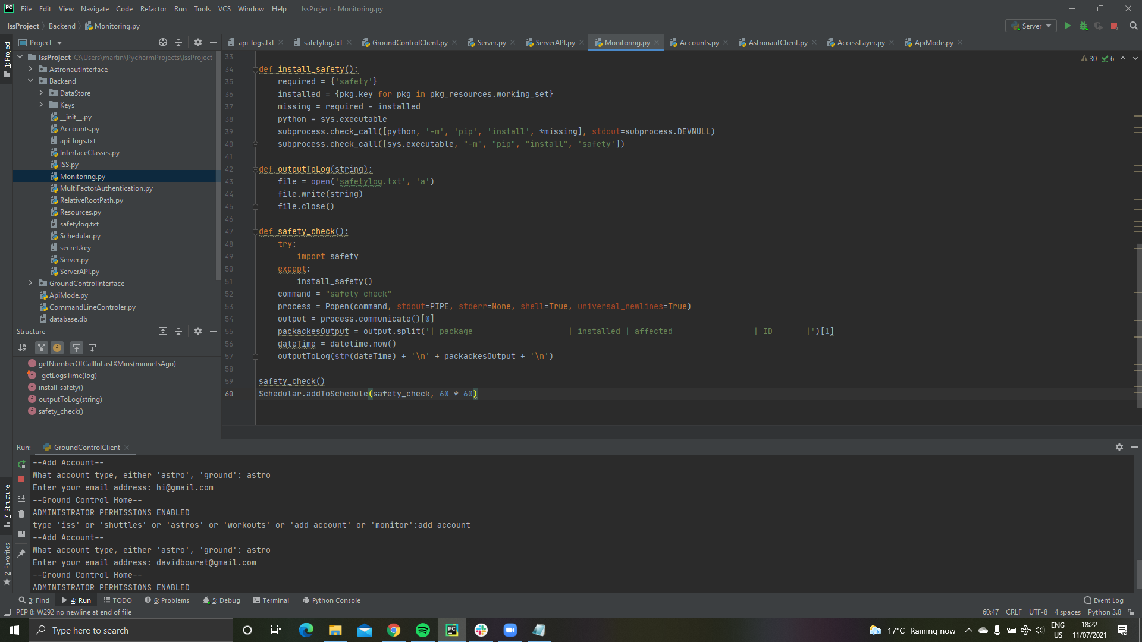
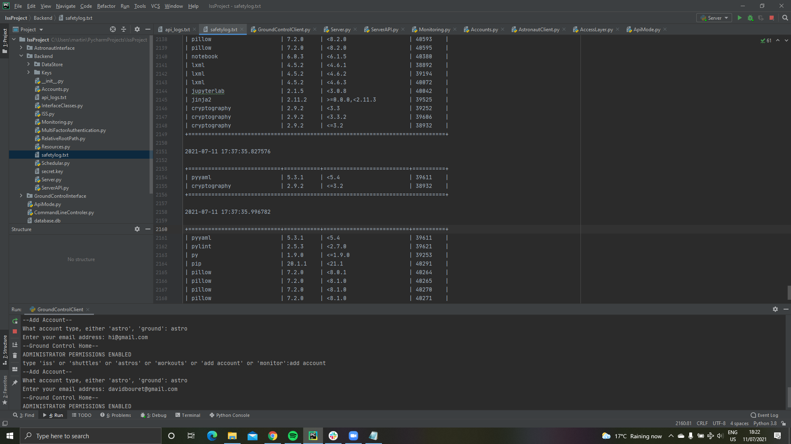
Server
Logging and vulnerability monitoring​
Log output to text file
Code for vulnerability monitoring
Vulnerability output

Slide 14
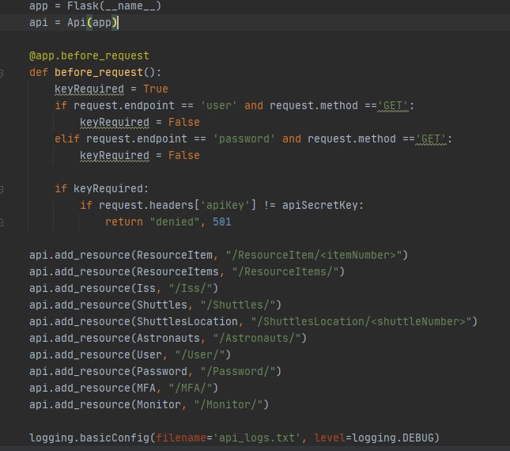
REST API
DDOS Monitoring
HTTPS Protocol (public certificate, private key)
TLS/SSL for transport layer security
Advanced privilege key
User
Submits correct login information
Server
Returns authentication key

Slide 15
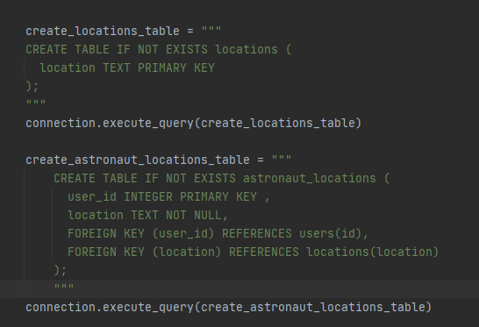
Data Access Layer
Data integrity enforced by SQL constraints

Slide 16
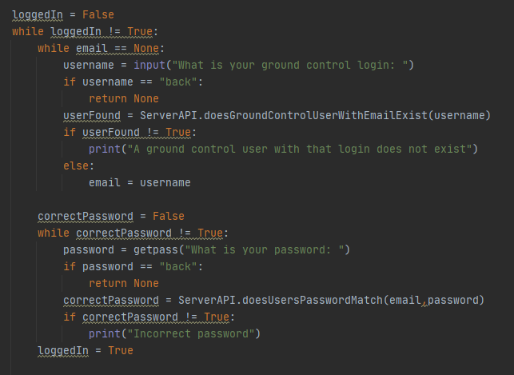
Client
Input validation

Slide 17
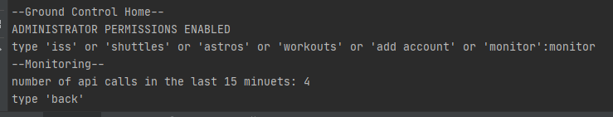
DDOS Monitoring

Slide 18
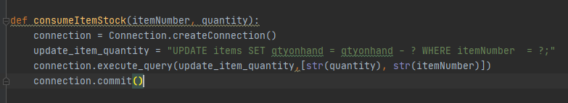
SQL injection attack prevention
We used parameterized queries, so that SQL injection attacks are prevented

Slide 19
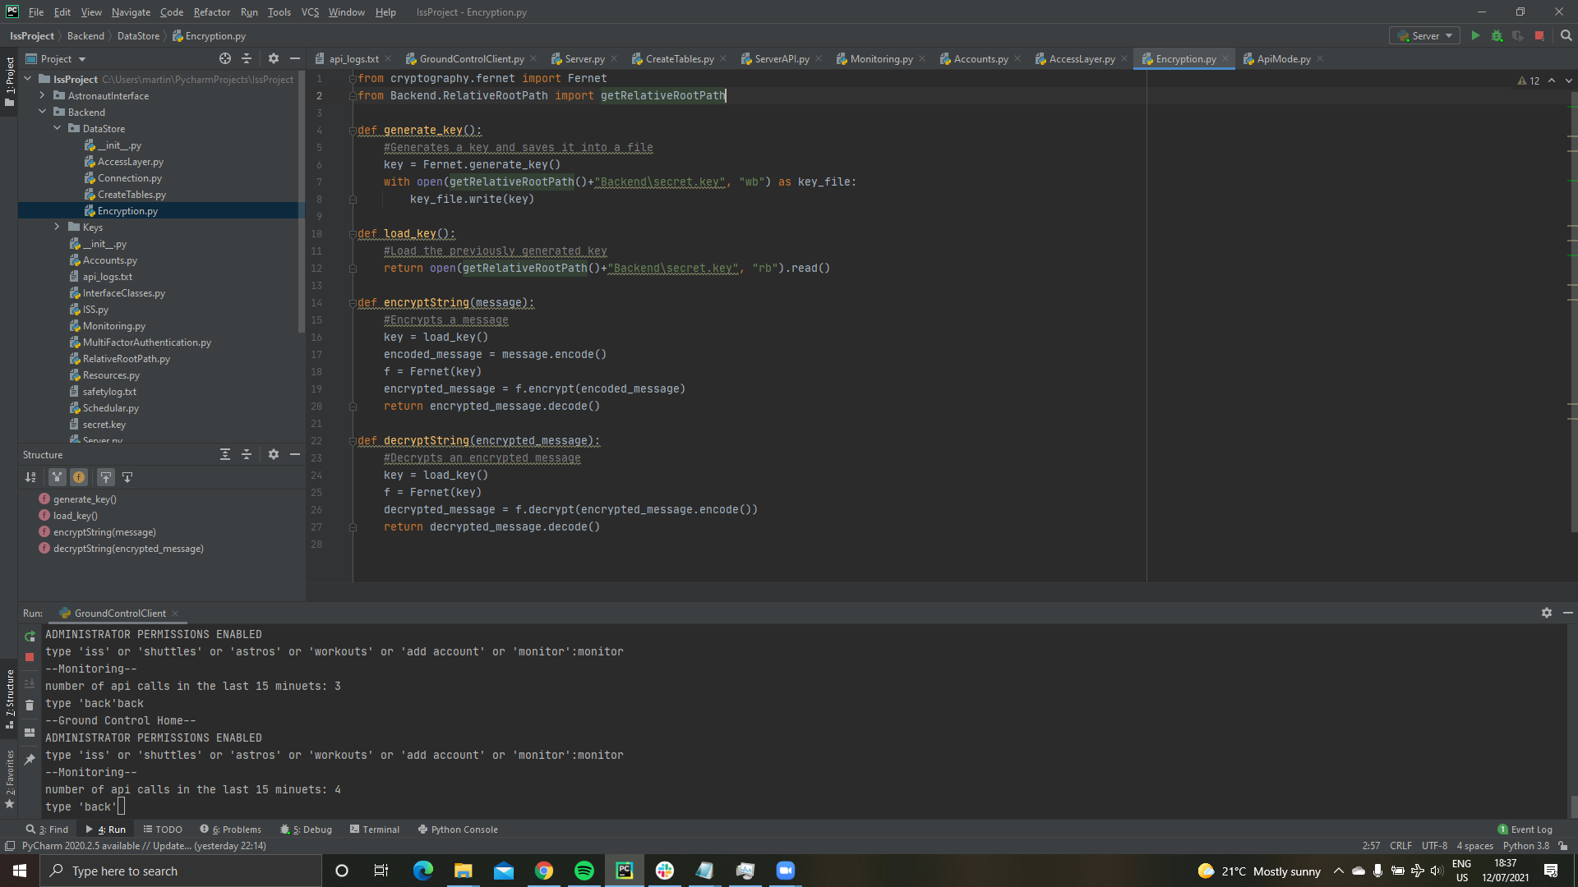
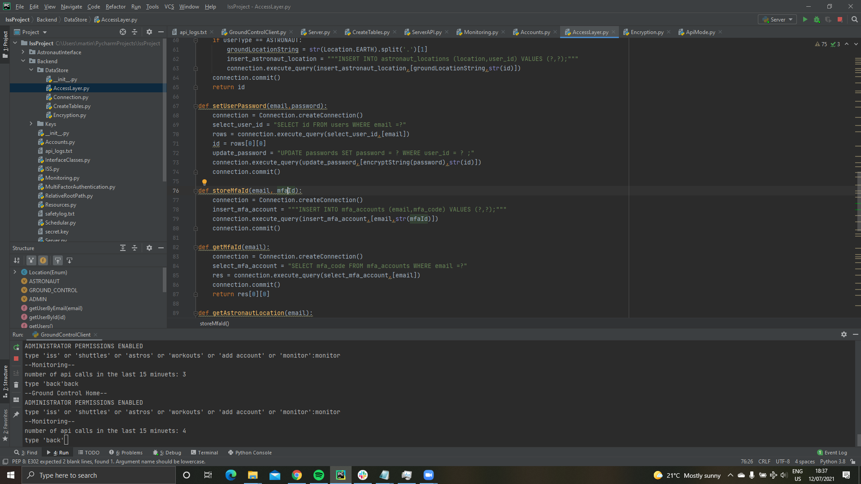
Cryptography

Slide 20
Roadmap to release
Our Flask server provides a synchronous service. If we were to scale the project up, we may want to use a server which can handle multiple concurrent requests, i.e., Asynchronous service
We may want to adopt a microservice architecture to help improve the projects scalability/modularity, as the project grows
We may want to consider using different programming languages of different paradigms that are most suitable for their specific applications, i.e., functional languages could help with scalable concurrency
The work we have done so far resembles the first sprint of an agile development process. Before proceeding to the next phase of development, we would want to consult with the project stakeholders to assess how closely the proposed prototypes meets their needs. We would want to use a form of secure SCRUM going forward.

Slide 21
Summary
Thank you for your attention and a big thank you to Dr. Peoples.

